Slide 1
Customer Churn Data Analysis Report
Task1: Data Gathering, Exploratory Data Analysis, and Data Preparation

Slide 2
Introduction
Customer churn is a critical challenge for financial institutions because acquiring new customers is significantly more expensive than retaining existing ones. Predicting churn enables organizations to proactively identify customers who may discontinue services and implement targeted retention strategies.
In this project, data analysis techniques were used to explore customer data and prepare it for building a predictive churn model. The objective of this task was to gather relevant datasets, perform exploratory data analysis (EDA), and clean and preprocess the data to ensure it is suitable for machine learning.

Slide 3
Data Gathering and Data Sources
To understand the factors influencing customer churn, multiple datasets were collected from different sources within the banking system. These datasets provide insights into customer demographics, financial behavior, digital engagement, and service interactions.

Slide 4
Customer Demographics
This dataset contains personal information about customers, including age, gender, marital status, and income level. Demographic attributes often influence customer financial behavior and engagement patterns.
Transaction History
This dataset records customer spending behavior and transaction activity. Transaction data helps identify patterns in financial usage that may indicate disengagement or reduced banking activity.
Customer Service Interactions
This dataset includes records of customer service requests and interactions. Frequent complaints or support requests may indicate dissatisfaction, which can increase the likelihood of churn.

Slide 5
Online Activity
This dataset captures digital engagement metrics such as login frequency and usage of online banking platforms. Customers who interact less frequently with digital services may be more likely to discontinue their relationship with the bank.
Churn Status
This dataset contains the churn label, indicating whether a customer has left the bank's services. It serves as the target variable for predictive modeling. All datasets were integrated using the CustomerID field to create a unified dataset containing one record per customer.

Slide 6
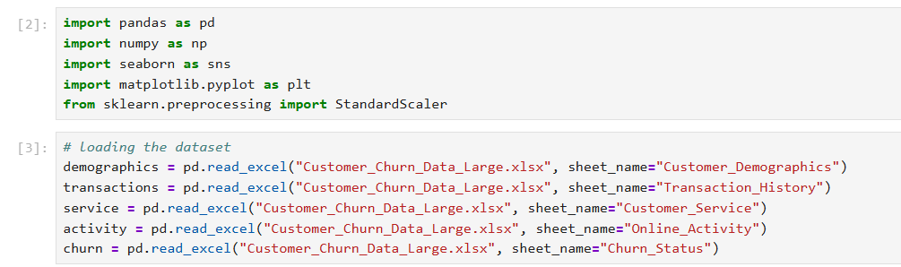

Slide 7
Data Integration
Since customer data was stored across multiple tables, the datasets were merged using the CustomerID key. This ensured that all relevant customer information was consolidated into a single dataset.
Transaction records were aggregated to compute total spending per customer, enabling a clear understanding of each customer's financial activity.
After merging the datasets, a unified dataset was created containing demographic attributes, transaction behavior, digital engagement metrics, and churn status.
This integrated dataset forms the foundation for exploratory analysis and predictive modeling.

Slide 8
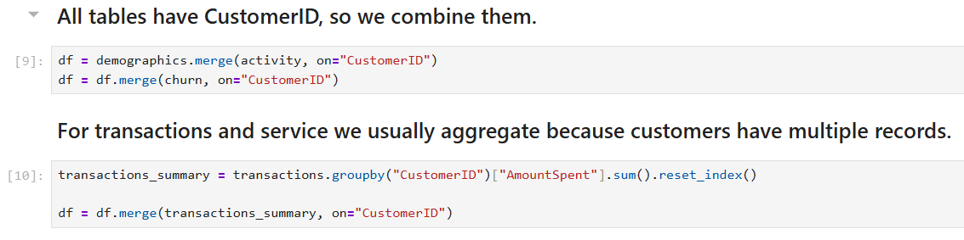

Slide 9
Exploratory Data Analysis (EDA)
Exploratory Data Analysis was performed to understand the structure of the dataset, identify trends, detect anomalies, and discover potential relationships between variables and customer churn.
EDA involved both statistical analysis and data visualization.

Slide 10
Age Distribution
A histogram was used to analyze the distribution of customer ages. The analysis shows that the customer base consists mainly of young to middle-aged individuals. Understanding the age distribution helps determine whether churn behavior varies across different age groups.
Transaction Spending Analysis
A boxplot was used to examine the distribution of Amount Spent by customers. The visualization showed that most transaction values fall within a reasonable range. No significant outliers were observed outside the whiskers of the boxplot, indicating that transaction spending values are relatively stable and do not require outlier removal.
Login Frequency and Customer Churn
A boxplot was used to compare login frequency between customers who churned and those who remained active. The analysis indicates that customers with lower login frequency tend to have a higher probability of churn. This suggests that reduced digital engagement may be an early indicator of customer disengagement.

Slide 11
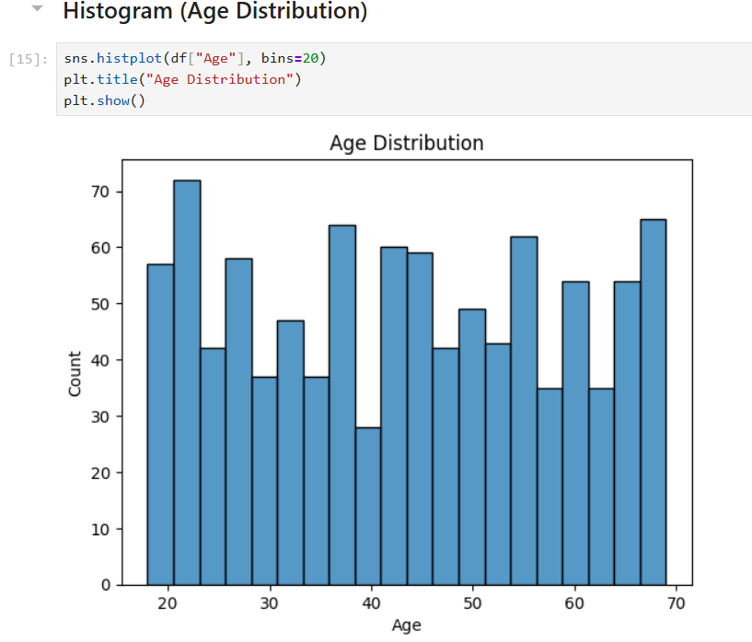

Slide 12
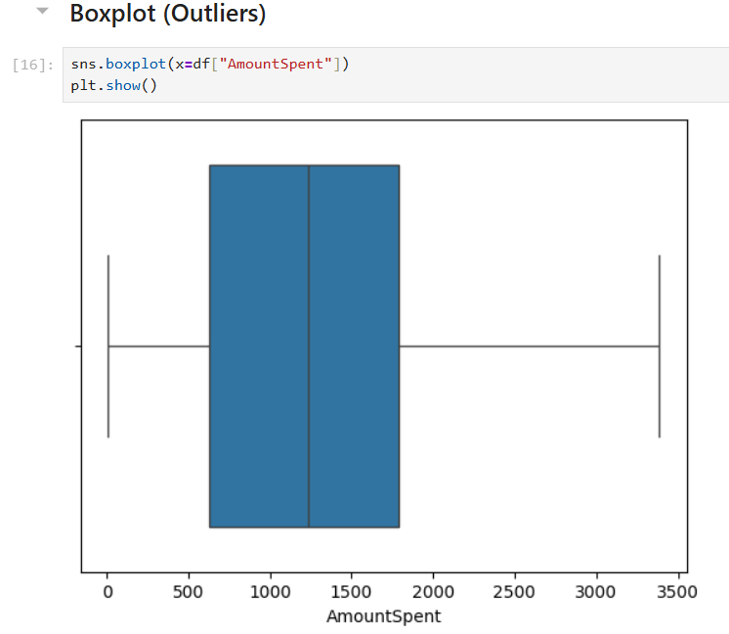

Slide 13
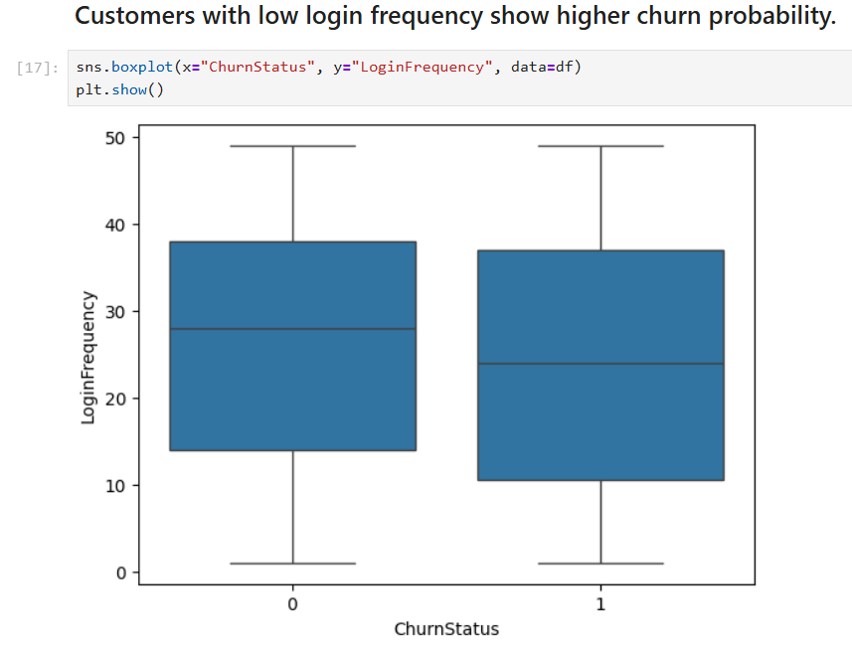

Slide 14
Gender Distribution
A count plot was used to analyze the distribution of customers by gender. The visualization helps determine whether the dataset is balanced between male and female customers. Understanding gender distribution is important because demographic factors may influence financial behavior and engagement patterns.
Income Level Distribution
A count plot was used to examine the distribution of customers across different income levels. Income segmentation helps identify whether customers with lower income levels exhibit higher churn tendencies due to pricing sensitivity or financial constraints.
Correlation Analysis
A correlation heatmap was generated to examine relationships between numerical variables. This analysis helps identify variables that may be strongly associated with customer churn, such as login frequency, transaction spending, or service usage. Understanding these relationships provides valuable insights for selecting features when building predictive models.

Slide 15
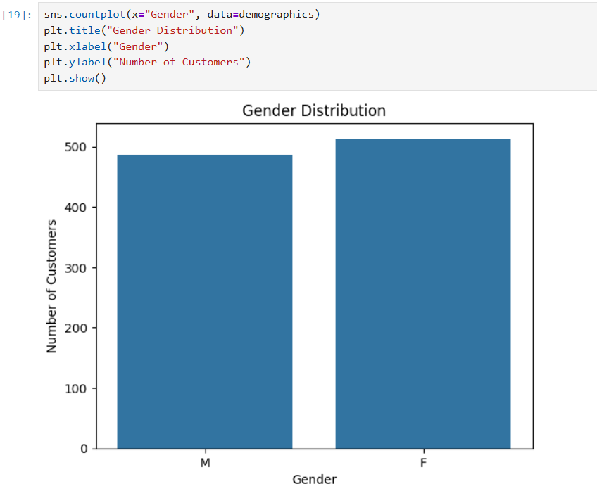

Slide 16
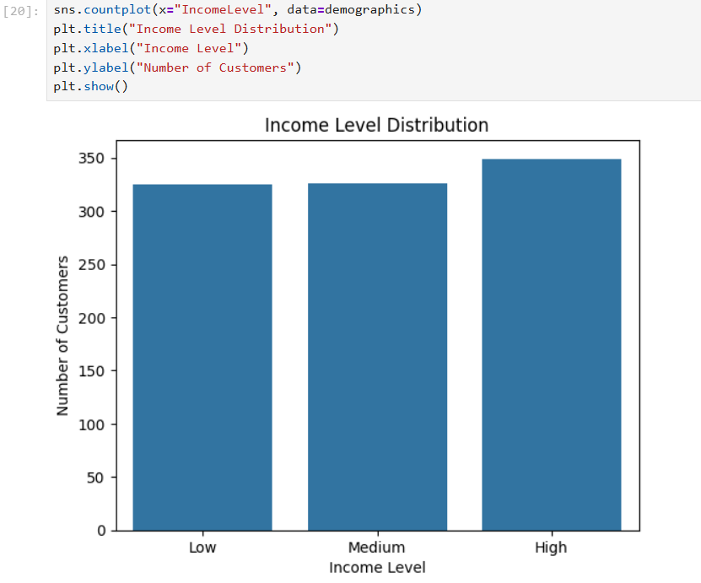

Slide 17
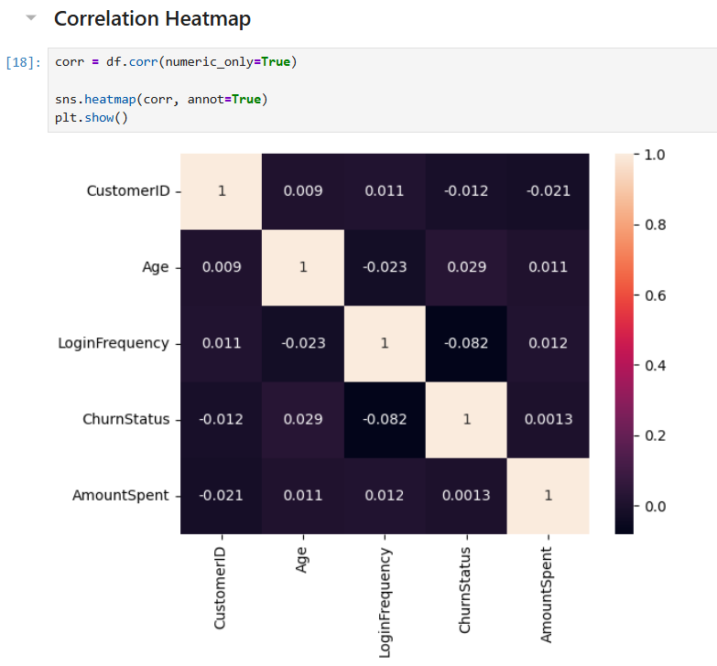

Slide 18
Data Cleaning and Preprocessing
Before building machine learning models, the dataset was cleaned and preprocessed to ensure data quality and consistency.
Handling Missing Values
The dataset was examined for missing values using data profiling techniques. The analysis showed that there were no significant missing values in the dataset. Therefore, no imputation or removal of records was required.

Slide 19
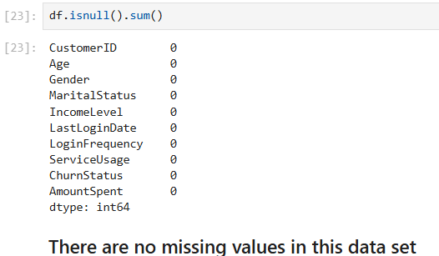

Slide 20

Outlier Detection
Outliers were analyzed using boxplots, particularly for the AmountSpent variable. The analysis indicated that transaction values were within acceptable ranges and no extreme outliers were detected. As a result, no outlier treatment was necessary.
Encoding Categorical Variables
Machine learning algorithms require numerical input, so categorical variables such as:
Gender
Marital Status
Income Level
Service Usage were transformed using One-Hot Encoding.
This method converts each category into a binary variable while preventing the model from assuming an ordinal relationship between categories.

Slide 21
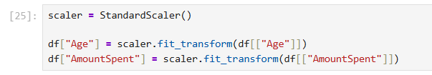
Feature Scaling
To ensure that numerical features contribute equally to machine learning algorithms, feature scaling was applied.
Numerical variables such as:
Age
Transaction Amount were standardized using Standardization (Z-score scaling) so that they have a mean of zero and a standard deviation of one.
This step improves model performance and prevents features with larger scales from dominating the learning process.

Slide 22
Final Prepared Dataset
After completing the preprocessing steps, the final dataset contains:
Cleaned and standardized numerical variables
Encoded categorical variables
Aggregated transaction data
Customer churn status
Each row in the dataset represents a single customer, making it suitable for training machine learning models.
The prepared dataset is now ready to be used for predictive modeling to identify customers who are at risk of churning.

Slide 23
Conclusion
This task involved gathering and preparing data for customer churn prediction. Multiple datasets were integrated to capture different aspects of customer behavior, including demographics, financial activity, digital engagement, and customer service interactions.
Exploratory data analysis revealed important patterns, such as the relationship between login frequency and customer churn. Data cleaning and preprocessing steps ensured that the dataset is structured, consistent, and suitable for machine learning algorithms.
The final dataset provides a solid foundation for building predictive models that can help the bank identify customers at risk of churn and implement targeted retention strategies.

Slide 24
Customer Churn Prediction Using Machine Learning
Task 2 – Building and Evaluating a Predictive Model

Slide 25
Introduction
Customer churn prediction is an important analytical problem for financial institutions because retaining existing customers is significantly more cost-effective than acquiring new ones. Identifying customers who are likely to discontinue banking services allows organizations to proactively implement targeted retention strategies.
In this task, a machine learning model was developed to predict customer churn using the preprocessed dataset prepared in Task 1. The model analyses customer demographics, financial behaviour, service usage, and digital engagement patterns to identify customers who are most likely to leave the bank.
The objective of this task is to build a predictive model that not only achieves strong performance but also provides interpretable insights that can support business decision-making.

Slide 26
Problem Definition
Customer churn prediction is formulated as a binary classification problem, where the goal is to predict whether a customer will leave the bank. The machine learning model uses various customer features to estimate the probability that a customer will churn.

Slide 27
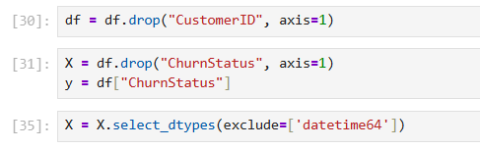
Feature Selection
The predictive model was trained using the cleaned dataset created in Task 1. The dataset contains multiple features representing customer characteristics and behaviour.
Key features include:
Age
Transaction amount
Login frequency
Gender
Income level
Marital status

Slide 28
Service usage (Online Banking / Website)
These variables capture important aspects of customer engagement and financial activity, which are often strong indicators of churn behaviour.
Before training the model, non-numerical and identifier columns such as CustomerID and date fields were removed to ensure compatibility with machine learning algorithms.

Slide 29
Algorithm Selection
Several machine learning algorithms were considered for churn prediction, including:
Logistic Regression
Decision Trees
Random Forest
Gradient Boosting
Support Vector Machines
For this task, Logistic Regression was selected as the primary model.

Slide 30
Reasons for Selecting Logistic Regression
Interpretability
Logistic regression provides clear insights into how each feature influences churn probability. This interpretability is important for business stakeholders who need to understand the drivers of customer churn.
Efficiency
The algorithm is computationally efficient and performs well on structured tabular data.
Probability Output
Logistic regression produces probability estimates, allowing the business to rank customers based on their risk of churn and prioritise intervention strategies.

Slide 31
Model Training
The dataset was divided into training and testing sets using an 80/20 split.
80% of the data was used for training the model
20% of the data was used for evaluating model performance
The Logistic Regression model was trained using the training dataset, enabling the algorithm to learn patterns that distinguish churned customers from retained customers.
To ensure model stability and avoid convergence issues, the maximum number of iterations was increased during training.

Slide 32
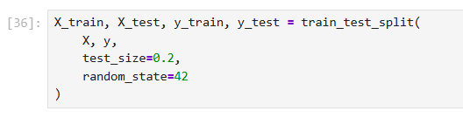
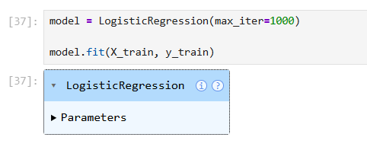

Slide 33
Model Evaluation
The trained model was evaluated using several performance metrics to obtain a comprehensive understanding of its effectiveness.
Accuracy
Accuracy measures the proportion of correctly predicted instances among all predictions. It provides an overall measure of model performance.
However, accuracy alone may not fully represent performance when the dataset is imbalanced.

Slide 34
Precision
Precision measures the proportion of predicted churn cases that were actually churned customers.
This metric is important when minimizing false positives is a priority.
Recall
Recall measures the proportion of actual churned customers that were correctly identified by the model.
In churn prediction, recall is especially important because failing to identify churn customers may lead to lost revenue opportunities.
F1 Score
The F1 score is the harmonic mean of precision and recall. It provides a balanced evaluation of model performance when both false positives and false negatives are important.

Slide 35
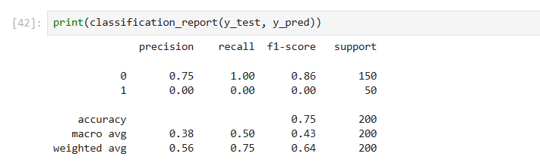

Slide 36
Confusion Matrix
A confusion matrix was used to visualize the classification results and understand the types of prediction errors.
The confusion matrix contains four components:
This analysis helps evaluate the practical reliability of the model.
Prediction Type | Explanation
True Positive | Correctly predicted churn
True Negative | Correctly predicted non-churn
False Positive | Predicted churn but customer stayed
False Negative | Customer churned but model predicted retention

Slide 37
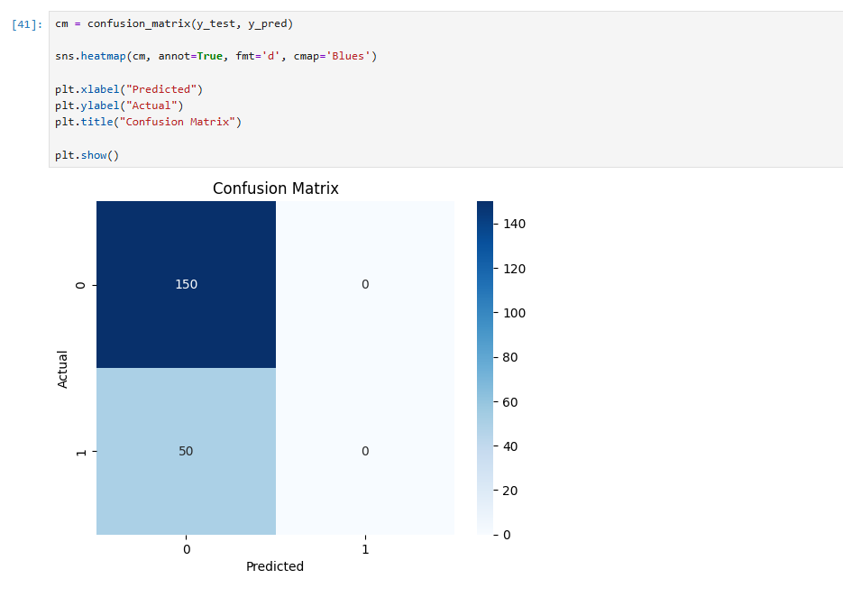

Slide 38
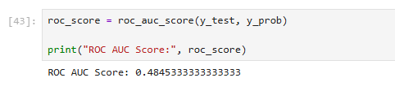
ROC-AUC Score
The Receiver Operating Characteristic – Area Under Curve (ROC-AUC) metric evaluates the model’s ability to distinguish between churned and retained customers across different probability thresholds.
A higher ROC-AUC score indicates stronger classification performance.

Slide 39
Model Insights
The model provided several insights into customer behaviour patterns associated with churn.
Login Frequency
Customers with lower login frequency were more likely to churn, suggesting that reduced engagement with digital banking services may indicate dissatisfaction or declining interest.
Transaction Behavior
Customers with lower transaction activity were more likely to discontinue their relationship with the bank.
Service Usage
Customers who rarely used online banking services showed higher churn probability compared to digitally active customers.

Slide 40
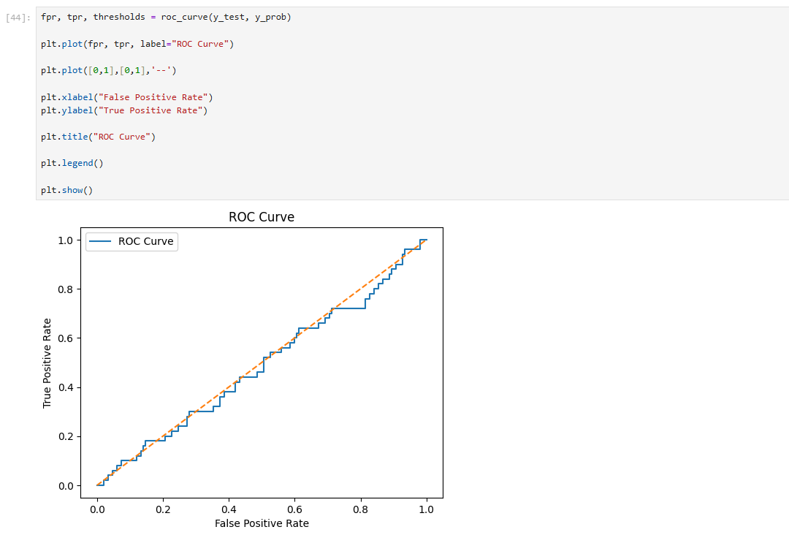
Income Level
Income segments showed slight differences in churn behaviour, indicating that financial capacity may influence customer retention.
These insights provide valuable guidance for targeted retention initiatives.

Slide 41
Business Applications
The predictive churn model can support several business initiatives at Lloyds Banking Group.
Targeted Customer Retention
The model can identify high-risk customers, enabling the bank to proactively offer personalized retention incentives.
Personalized Engagement
Customers with declining digital activity can receive tailored communication encouraging them to use digital banking services more frequently.
Customer Support Interventions
Customers who frequently contact customer support can be identified early and provided with improved service experiences.

Slide 42
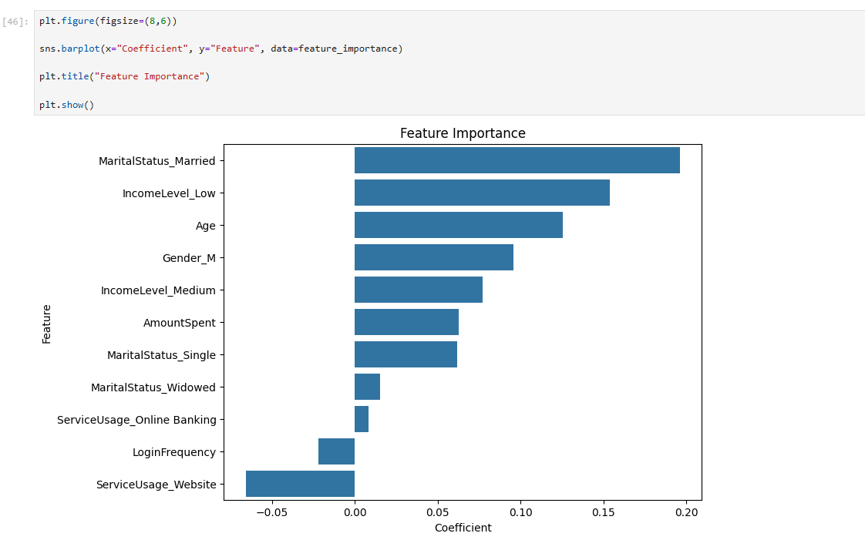
Marketing Optimization
Marketing teams can focus their retention campaigns on customers with the highest churn probability, improving campaign efficiency.

Slide 43
Potential Improvements
While the current model provides valuable insights, several improvements could enhance its predictive performance.
Advanced Algorithms
Future iterations could evaluate more complex models such as Random Forest, Gradient Boosting, or XGBoost to capture non-linear relationships.
Handling Class Imbalance
Techniques such as SMOTE or class weighting could improve the model’s ability to detect churn cases.
Feature Engineering
Additional behavioral features, such as customer tenure, transaction trends, and service interaction frequency, may further improve model performance.

Slide 44
Conclusion
In this task, a machine learning model was developed to predict customer churn using demographic, behavioral, and transactional data.
Logistic Regression was selected due to its interpretability and effectiveness for binary classification problems. The model was trained on a structured dataset prepared in Task 1 and evaluated using multiple performance metrics, including precision, recall, F1 score, and ROC-AUC.
The analysis revealed key indicators of churn, such as reduced login frequency and lower transaction activity. These insights can help Lloyds Banking Group implement proactive retention strategies and improve customer engagement.
The predictive model provides a strong foundation for data-driven customer retention initiatives and can be further enhanced with advanced machine learning techniques in future iterations.

